Slide 1
สถาปัตยกรรม ESP32
Microcontroller ที่ใช้ในวิชานี้

Slide 2
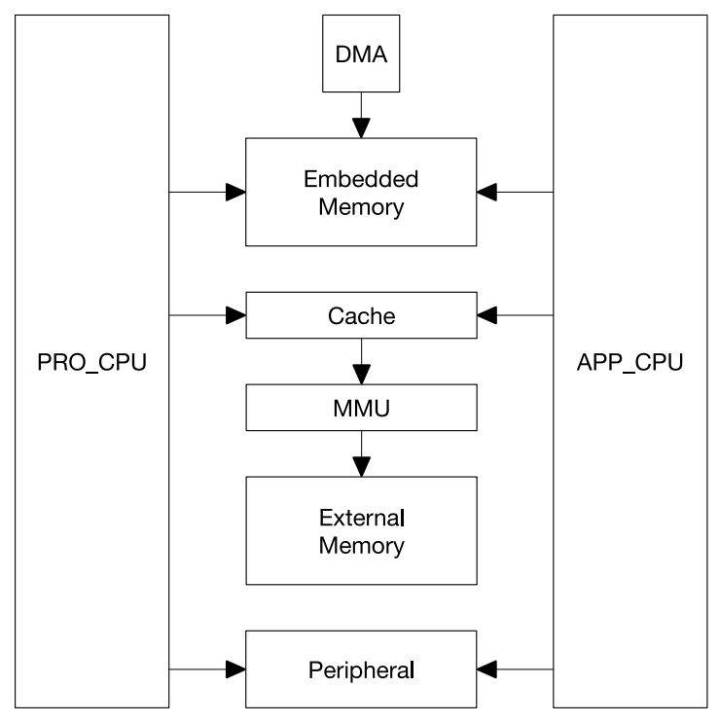
System Structure

Slide 3
Memory and System
The ESP32 is a dual-core system with two Harvard Architecture Xtensa LX6 CPUs.
All embedded memory, external memory and peripherals are located on the data bus and/or the instruction bus of these CPUs.

Slide 4
Memory and System
The ESP32 is a dual-core system with two Harvard Architecture Xtensa LX6 CPUs. All embedded memory, external memory and peripherals are located on the data bus and/or the instruction bus of these CPUs.
With some minor exceptions (see below), the address mapping of two CPUs is symmetric, meaning that they use the same addresses to access the same memory. Multiple peripherals in the system can access embedded memory via DMA.
The two CPUs are named “PRO_CPU” and “APP_CPU” (for “protocol” and “application”), however, for most purposes the two CPUs are interchangeable

